Slide 1
Neurofeedback Training Task

Slide 2
Firstly…
Thanks for trying this out!
We’re excited to be piloting the Activa PC+S device for neurofeedback studies, and hope you are the first of many patients

Slide 3
Task
The neurofeedback task consists of two parts:
1. Calibration
2. Neurofeedback ‘Mario Jumping’ Game

Slide 4
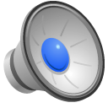
Calibration
1 minute recording of instructed elbow flexion and extension movements
Throughout the minute you will hear occasional beeps
When you hear a beep, extend or flex your elbow and hold in that position
Sample file
Notes:
example_beep_freq(time_sec)

Slide 5
Neurofeedback Task
Blocks of 5-10 minutes of the neurofeedback task
Target hitting task with a ‘Mario Cursor’
Goal is to get Mario in the target quickly to be able to do as many targets as possible per block
Mario is controlled by your motor ECOG electrodes (beta power specifically)

Slide 6
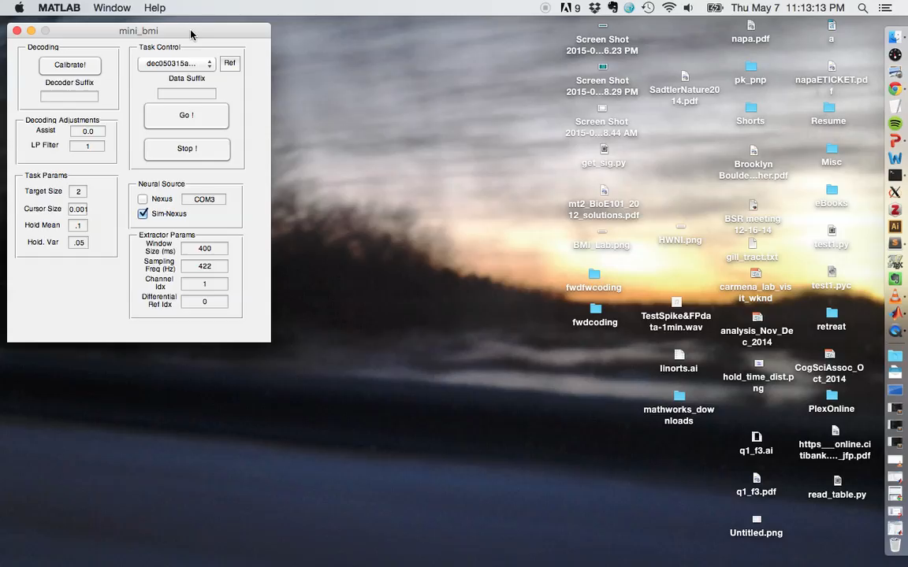
Demo:

Slide 7
Other Details
After each block, feel free to take as long of a break as needed
Practicing:
Though the task may be difficult at first, many patients who practice ‘brain-machine interface’ tasks report that their performance and ease of control improves after practice, much like a typical motor skill

Slide 8
Future Directions
Pairing with motor task, for immediate evaluation of motor state after feedback
Next session, we aim to have subjects complete a finger tapping task as part of each trial (or blocks of trials)

